Slide 1

Computer System Servicing

Slide 2

Motivation:

Slide 3
Personal Protective Equipment (PPE)

Slide 4
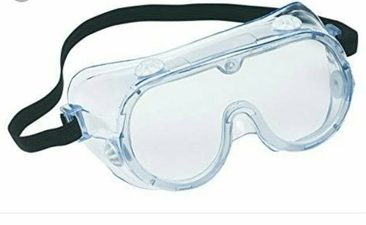
Personal Protective Equipment (PPE)
GOGGLES
A large spectacle, with shield around the edges to protect the eyes from pollen, excessive glare, wind, etc.

Slide 5

Personal Protective Equipment (PPE)
2. RUBBER SOLE SHOES
A special type of shoes used to resist electrical shock both for waterproofing and insulating purposes.

Slide 6
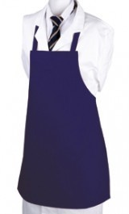
Personal Protective Equipment (PPE)
3. APRON
A fabric as a cloth cover over the front of the body.

Slide 7
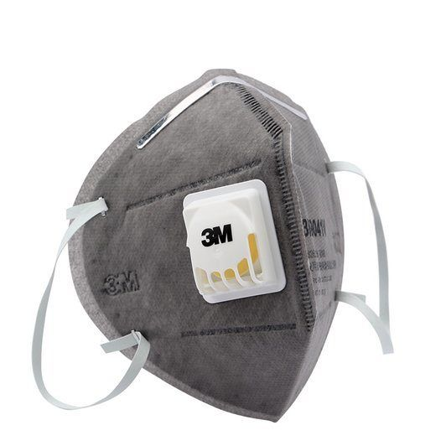
Personal Protective Equipment (PPE)
4. FACE MASK
A mask shield to avoid the inhalation or ingestion of particles and other contaminants.

Slide 8

Personal Protective Equipment (PPE)
5. GLOVES
These gloves are used while handling electronic applications because static charges can destroy sensitive electronics parts.

Slide 9
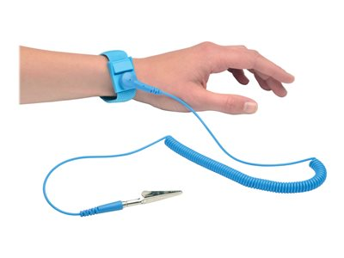
Personal Protective Equipment (PPE)
6. ANTI-STATIC WRIST STRAP
It is an antistatic tool that is used to firmly ground a person operating on very sensitive electronic devices to avoid the accumulation of static electricity that can lead to ESD in their body.

Slide 10

Personal Protective Equipment (PPE)
7. ANTI-STATIC MAT
Is an anti-static system that protects a person or piece of equipment from electrostatic discharge.

Slide 11
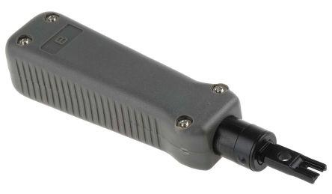
Personal Protective Equipment (PPE)
8. PUNCH DOWN TOOL/IMPACT TOOL
Use to connect wires to patch panel and modular jack/Krone Jack.

Slide 12
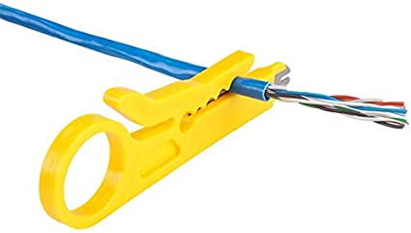
Personal Protective Equipment (PPE)
9. WIRE STRIPPER
Use to cut and strip wire for matching different cable sizes.

Slide 13
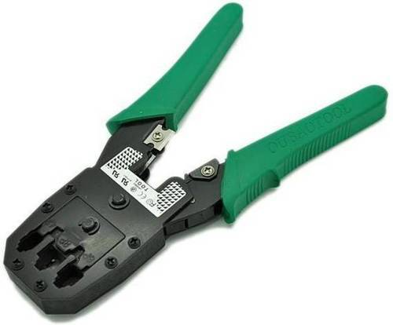
Personal Protective Equipment (PPE)
10. CRIMPING TOOL
This is a special tool used to cut, hold, and attach an RJ45 jack to the end of the cable.

Slide 14

Personal Protective Equipment (PPE)
11. LAN TESTER
An electronic device used to verify the connection in a signal cable.

Slide 15
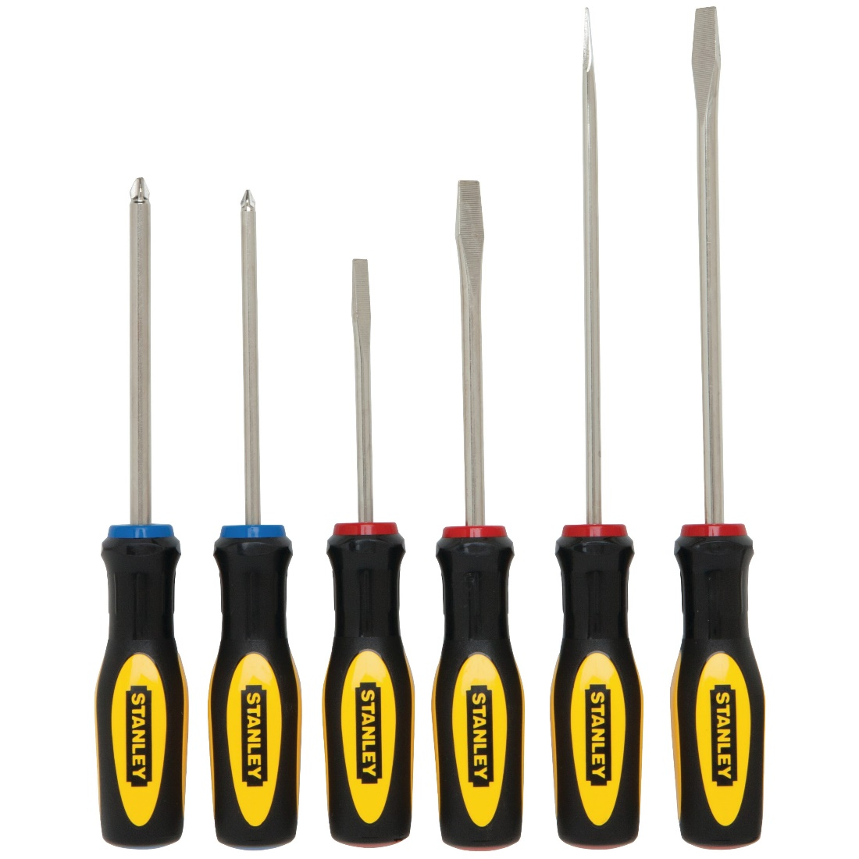
Personal Protective Equipment (PPE)
12. SCREW DRIVER SET
Hand held devices to mount and remove fasteners or screw and rely on the operator’s physical capabilities to provide precise force when using the screw driver handle when turning clockwise or counter clockwise.

Slide 16
FORMATIVE ASSESSMENT
Direction: Give the name and function of the following PPE;

Slide 17
FORMATIVE ASSESSMENT

Slide 18
FORMATIVE ASSESSMENT

Slide 19
FORMATIVE ASSESSMENT

Slide 20
Practical Application of the acquired
Learning Competencies

Slide 21

GENERALIZATION

Slide 22
THANK YOU!!!

